Slide 1
BIEN 401 Biomedical Mass Transport Class 15 Pharmacokinetic Analysis Part 2
notes prepared by
Dr. Louis Reis
Created on 4/9/2022

Slide 2

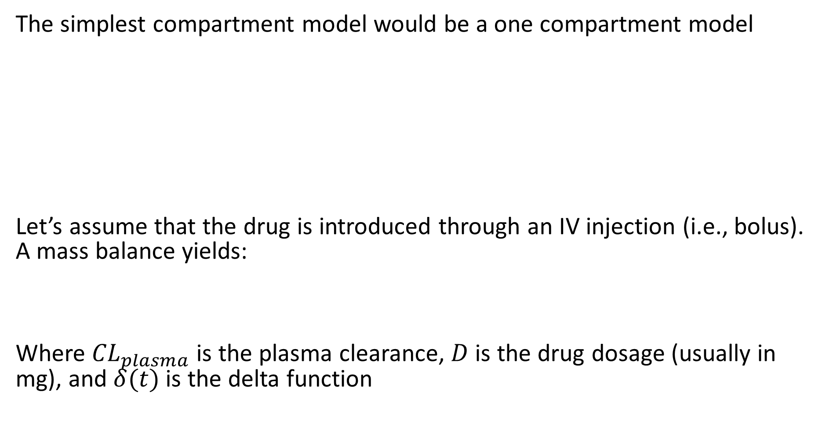


One Compartment Model
The simplest compartment model would be a one compartment model
Let’s assume that the drug is introduced through an IV injection (i.e., bolus). A mass balance yields:
Where ${CL}_{plasma}$ is the plasma clearance, $D$ is the drug dosage (usually in mg), and $δ(t)$ is the delta function
Drug
$$k_{e}$$
Clearance by inactivation or excretion
$$V_{apparent}$$
$$C_{total}$$
Reminder:
$$δ\left(t=0\right)=1$$
$$δ\left(t≠0\right)=0$$

Slide 3
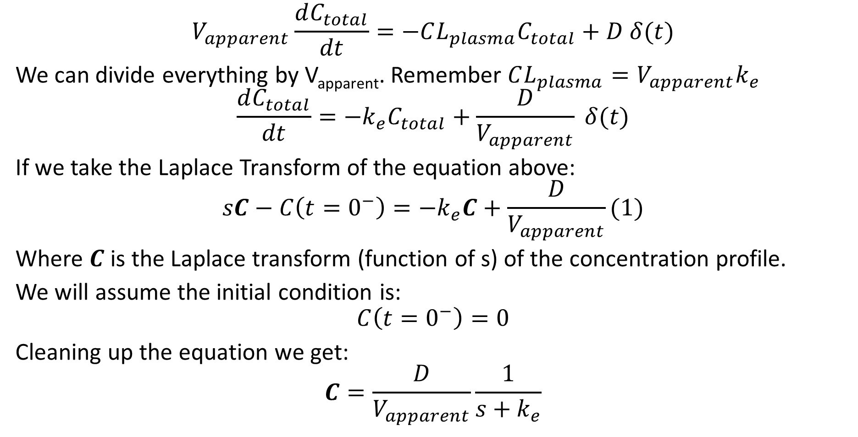
One Compartment Model – IV Injection
$$V_{apparent}\frac{dC_{total}}{dt}=−CL_{plasma}C_{total}+D δ(t)$$
We can divide everything by V_{apparent}. Remember $CL_{plasma}=V_{apparent}k_{e}$
$$\frac{dC_{total}}{dt}=−k_{e}C_{total}+\frac{D}{V_{apparent}} δ(t)$$
If we take the Laplace Transform of the equation above:
$$sC−C\left(t=0^{−}\right)=−k_{e}C+\frac{D}{V_{apparent}}(1)$$
Where $C$ is the Laplace transform (function of s) of the concentration profile.
We will assume the initial condition is:
$$C\left(t=0^{−}\right)=0$$
Cleaning up the equation we get:
$$C=\frac{D}{V_{apparent}}\frac{1}{s+k_{e}}$$

Slide 4
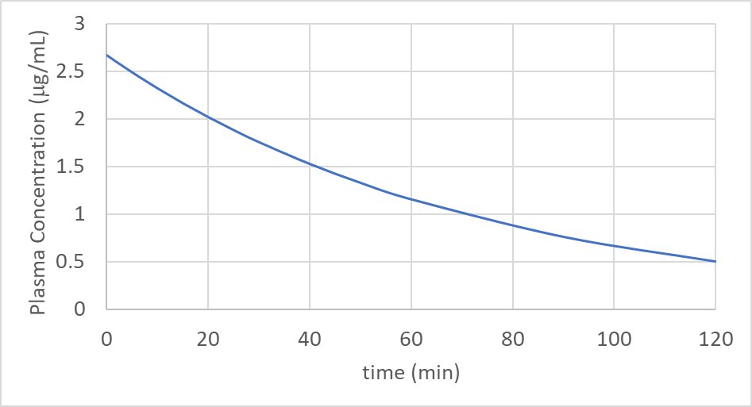
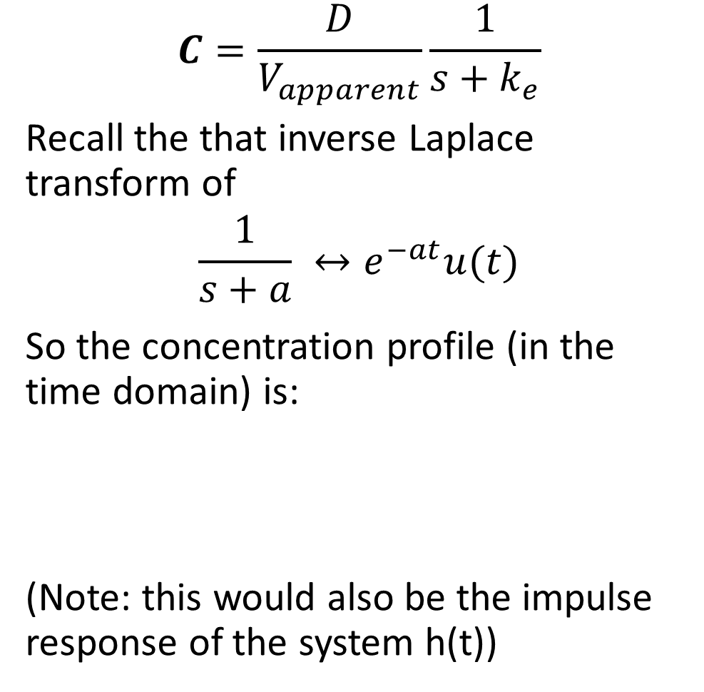
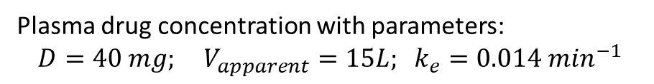
One Compartment Model – IV Injection
$$C=\frac{D}{V_{apparent}}\frac{1}{s+k_{e}}$$
Recall the that inverse Laplace transform of
$$\frac{1}{s+a} ↔e^{−at}u(t)$$
So the concentration profile (in the time domain) is:
(Note: this would also be the impulse response of the system h(t))
Plasma drug concentration with parameters:
$$D=40 mg; V_{apparent}=15L; k_{e}=0.014 m{in}^{−1}$$

Slide 5

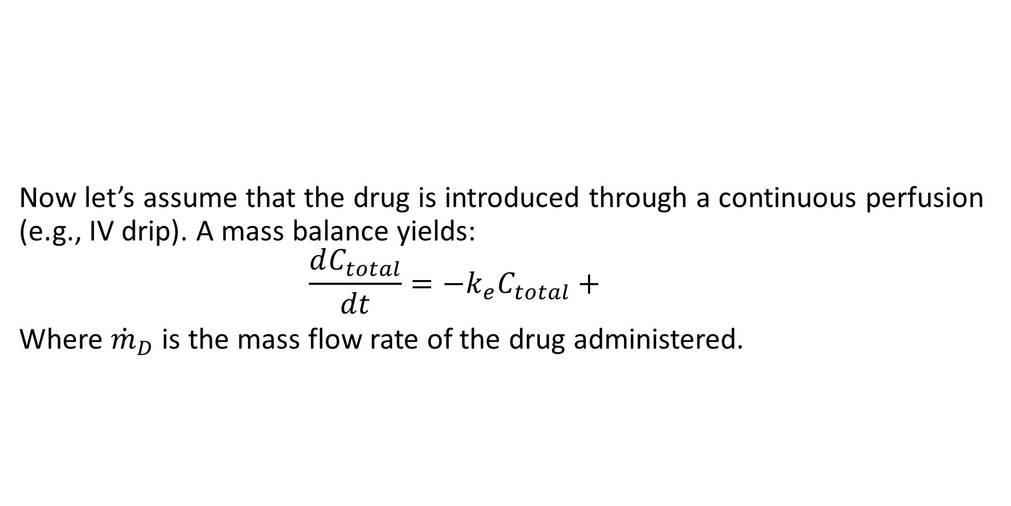

One Compartment Model – Continuous Perfusion
Now let’s assume that the drug is introduced through a continuous perfusion (e.g., IV drip). A mass balance yields:
$$\frac{dC_{total}}{dt}=−k_{e}C_{total}+$$
Where ${\dot{m}}_{D}$is the mass flow rate of the drug administered.
Drug
$$k_{e}$$
Clearance by inactivation or excretion
$$V_{apparent}$$
$$C_{total}$$

Slide 6
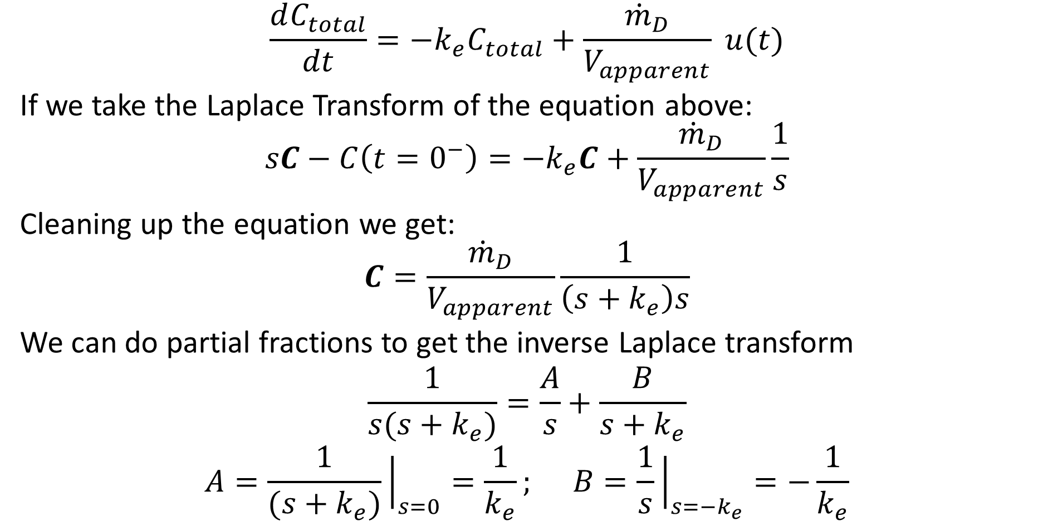
One Compartment Model – Continuous Perfusion
$$\frac{dC_{total}}{dt}=−k_{e}C_{total}+\frac{{\dot{m}}_{D}}{V_{apparent}} u(t)$$
If we take the Laplace Transform of the equation above:
$$sC−C\left(t=0^{−}\right)=−k_{e}C+\frac{{\dot{m}}_{D}}{V_{apparent}}\frac{1}{s}$$
Cleaning up the equation we get:
$$C=\frac{{\dot{m}}_{D}}{V_{apparent}}\frac{1}{\left(s+k_{e}\right)s}$$
We can do partial fractions to get the inverse Laplace transform
$$\frac{1}{s(s+k_{e})}=\frac{A}{s}+\frac{B}{s+k_{e}}$$
$$A=\frac{1}{(s+k_{e})}{\left.​\right|}_{s=0}=\frac{1}{k_{e}}; B=\frac{1}{s}{\left.​\right|}_{s=−k_{e}}=−\frac{1}{k_{e}}$$

Slide 7
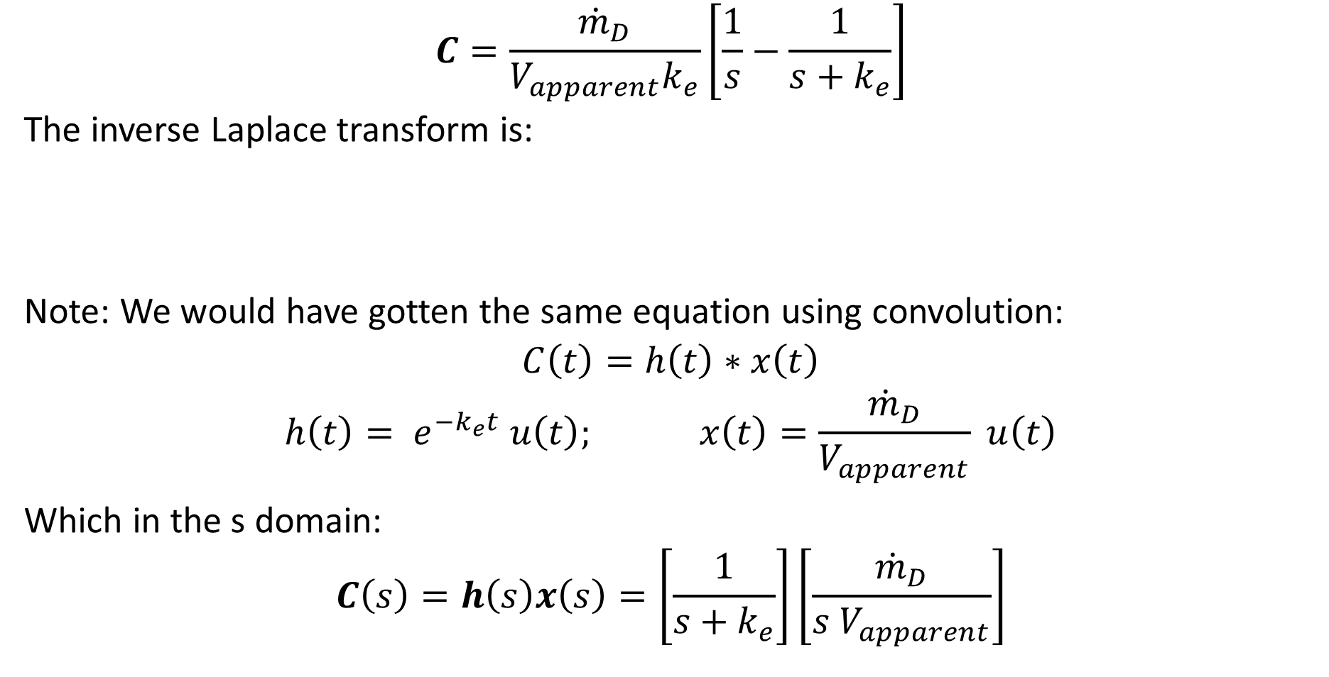
One Compartment Model – Continuous Perfusion
$$C=\frac{{\dot{m}}_{D}}{V_{apparent}k_{e}}\left[\frac{1}{s}−\frac{1}{s+k_{e}}\right]$$
The inverse Laplace transform is:
Note: We would have gotten the same equation using convolution:
$$C\left(t\right)=h\left(t\right)∗x\left(t\right)$$
$$h\left(t\right)= e^{−k_{e}t} u\left(t\right); x\left(t\right)=\frac{{\dot{m}}_{D}}{V_{apparent}} u\left(t\right)$$
Which in the s domain:
$$C\left(s\right)=h\left(s\right)x\left(s\right)=\left[\frac{1}{s+k_{e}}\right]\left[\frac{{\dot{m}}_{D}}{s V_{apparent}}\right]$$

Slide 8
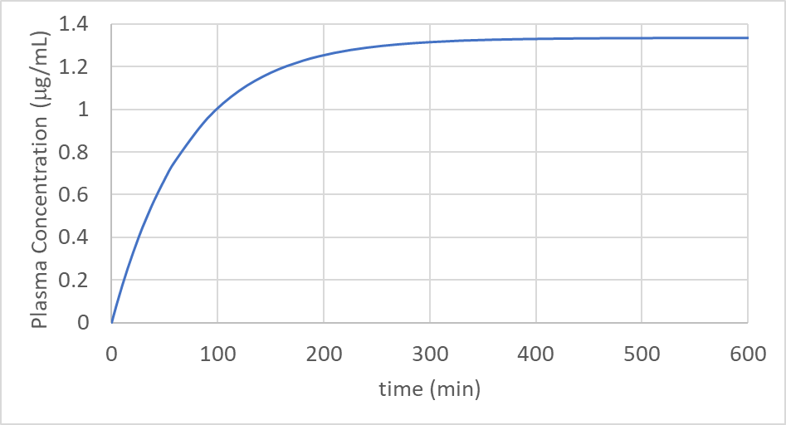
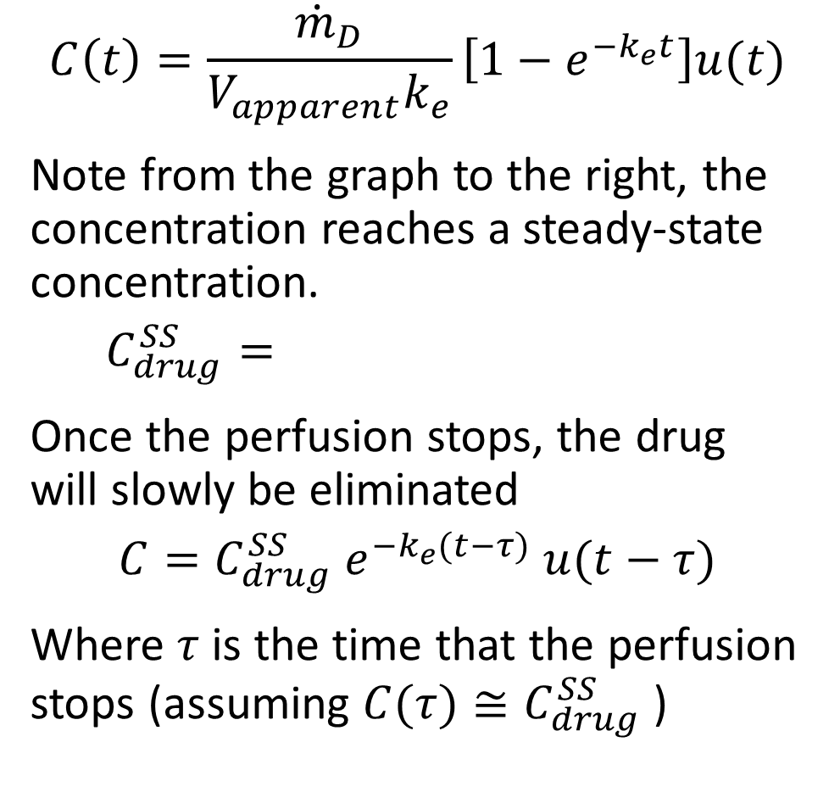
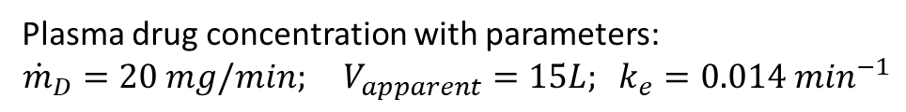
One Compartment Model – Continuous Perfusion
$$C\left(t\right)=\frac{{\dot{m}}_{D}}{V_{apparent}k_{e}}\left[1−e^{−k_{e}t}\right]u(t)$$
Note from the graph to the right, the concentration reaches a steady-state concentration.
$$C_{drug}^{SS}=$$
Once the perfusion stops, the drug will slowly be eliminated
$$C=C_{drug}^{SS} e^{−k_{e}(t−τ)} u(t−τ)$$
Where $τ$ is the time that the perfusion stops (assuming $C(τ)≅C_{drug}^{SS}$ )
Plasma drug concentration with parameters:
$${\dot{m}}_{D}=20 mg/min; V_{apparent}=15L; k_{e}=0.014 m{in}^{−1}$$

Slide 9
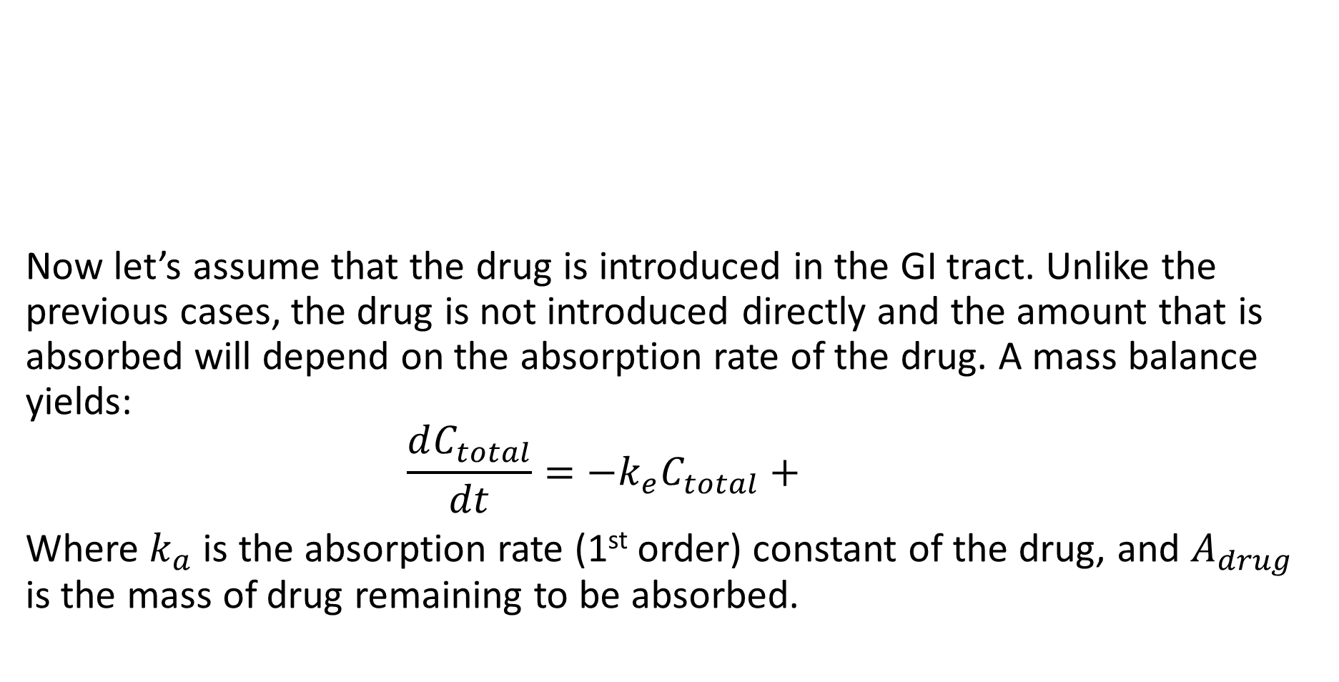
One Compartment Model – Drug Absorption
Now let’s assume that the drug is introduced in the GI tract. Unlike the previous cases, the drug is not introduced directly and the amount that is absorbed will depend on the absorption rate of the drug. A mass balance yields:
$$\frac{dC_{total}}{dt}=−k_{e}C_{total}+$$
Where $k_{a}$is the absorption rate (1st order) constant of the drug, and $A_{drug}$ is the mass of drug remaining to be absorbed.
Drug
$$k_{e}$$
Clearance by inactivation or excretion
$$V_{apparent}$$
$$C_{total}$$

Slide 10
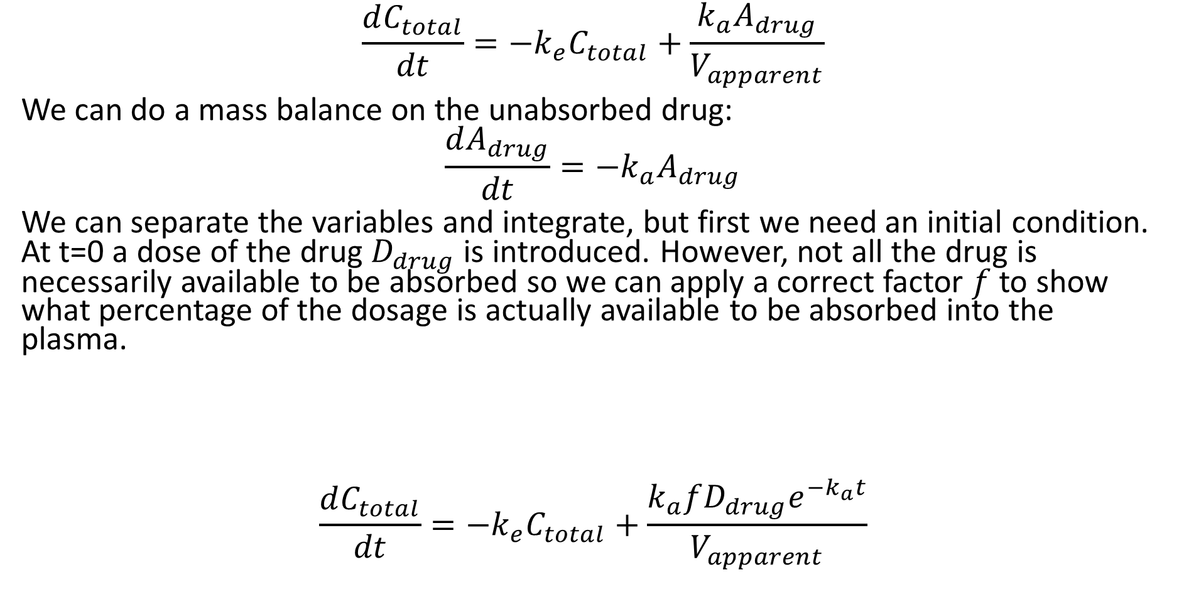
One Compartment Model – Drug Absorption
$$\frac{dC_{total}}{dt}=−k_{e}C_{total}+\frac{k_{a}A_{drug}}{V_{apparent}}$$
We can do a mass balance on the unabsorbed drug:
$$\frac{dA_{drug}}{dt}=−k_{a}A_{drug}$$
We can separate the variables and integrate, but first we need an initial condition. At t=0 a dose of the drug $D_{drug}$ is introduced. However, not all the drug is necessarily available to be absorbed so we can apply a correct factor $f$ to show what percentage of the dosage is actually available to be absorbed into the plasma.
$$\frac{dC_{total}}{dt}=−k_{e}C_{total}+\frac{k_{a}fD_{drug}e^{−k_{a}t}}{V_{apparent}}$$

Slide 11
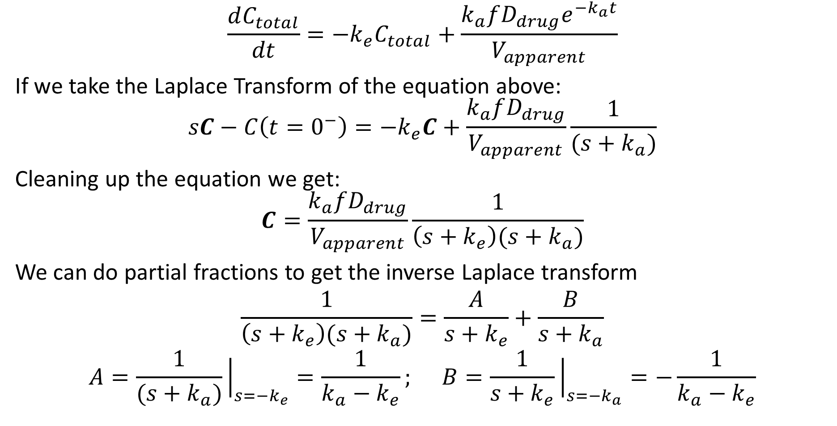
One Compartment Model – Drug Absorption
$$\frac{dC_{total}}{dt}=−k_{e}C_{total}+\frac{k_{a}fD_{drug}e^{−k_{a}t}}{V_{apparent}}$$
If we take the Laplace Transform of the equation above:
$$sC−C\left(t=0^{−}\right)=−k_{e}C+\frac{k_{a}fD_{drug}}{V_{apparent}}\frac{1}{(s+k_{a})}$$
Cleaning up the equation we get:
$$C=\frac{k_{a}fD_{drug}}{V_{apparent}}\frac{1}{\left(s+k_{e}\right)(s+k_{a})}$$
We can do partial fractions to get the inverse Laplace transform
$$\frac{1}{\left(s+k_{e}\right)(s+k_{a})}=\frac{A}{s+k_{e}}+\frac{B}{s+k_{a}}$$
$$A=\frac{1}{(s+k_{a})}{\left.​\right|}_{s=−k_{e}}=\frac{1}{k_{a}−k_{e}}; B=\frac{1}{s+k_{e}}{\left.​\right|}_{s=−k_{a}}=−\frac{1}{k_{a}−k_{e}}$$

Slide 12
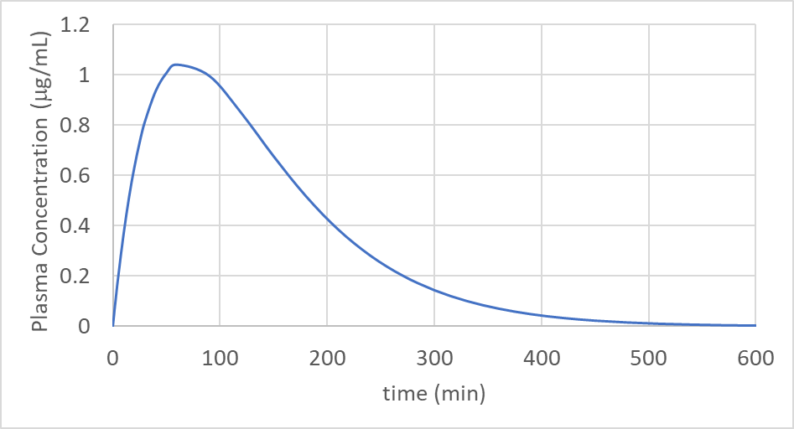
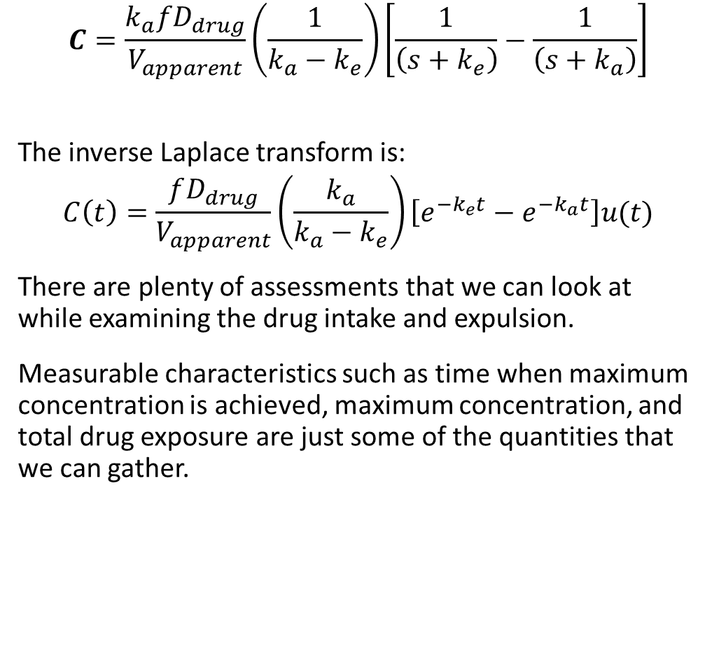
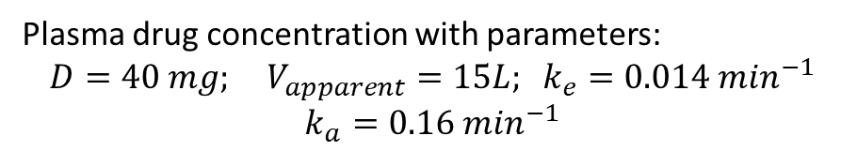
One Compartment Model – Drug Absorption
$$C=\frac{k_{a}fD_{drug}}{V_{apparent}}\left(\frac{1}{k_{a}−k_{e}}\right)\left[\frac{1}{\left(s+k_{e}\right)}−\frac{1}{\left(s+k_{a}\right)}\right]$$
The inverse Laplace transform is:
$$C\left(t\right)=\frac{fD_{drug}}{V_{apparent}}\left(\frac{k_{a}}{k_{a}−k_{e}}\right)\left[e^{−k_{e}t}−e^{−k_{a}t}\right]u(t)$$
There are plenty of assessments that we can look at while examining the drug intake and expulsion.
Measurable characteristics such as time when maximum concentration is achieved, maximum concentration, and total drug exposure are just some of the quantities that we can gather.
Plasma drug concentration with parameters:
$$D=40 mg; V_{apparent}=15L; k_{e}=0.014 m{in}^{−1}$$
$$k_{a}=0.16 m{in}^{−1}$$

Slide 13
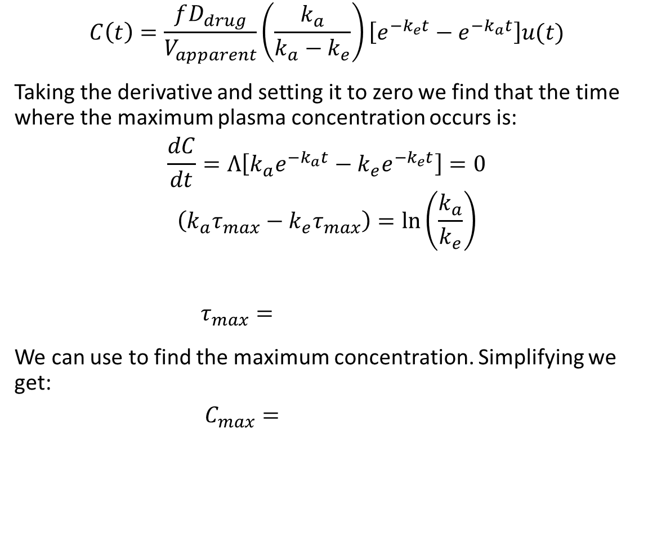
One Compartment Model – Drug Absorption
$$C\left(t\right)=\frac{fD_{drug}}{V_{apparent}}\left(\frac{k_{a}}{k_{a}−k_{e}}\right)\left[e^{−k_{e}t}−e^{−k_{a}t}\right]u(t)$$
Taking the derivative and setting it to zero we find that the time where the maximum plasma concentration occurs is:
$$\frac{dC}{dt}=Λ\left[k_{a}e^{−k_{a}t}−k_{e}e^{−k_{e}t}\right]=0$$
$$\left(k_{a}τ_{max}−k_{e}τ_{max}\right)=\ln\left(\frac{k_{a}}{k_{e}}\right)$$
$$τ_{max}=$$
We can use to find the maximum concentration. Simplifying we get:
$$C_{max}=$$

Slide 14
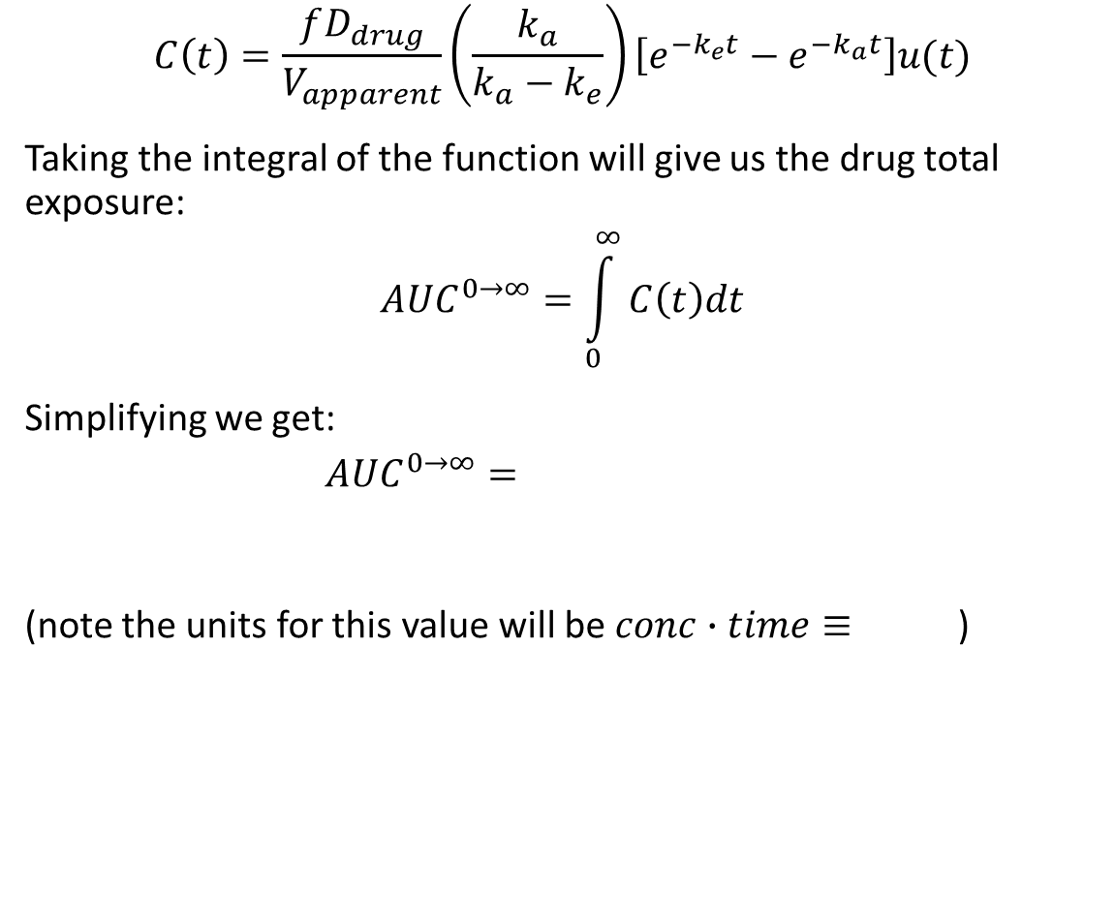
One Compartment Model – Drug Absorption
$$C\left(t\right)=\frac{fD_{drug}}{V_{apparent}}\left(\frac{k_{a}}{k_{a}−k_{e}}\right)\left[e^{−k_{e}t}−e^{−k_{a}t}\right]u(t)$$
Taking the integral of the function will give us the drug total exposure:
$$AUC^{0→∞}=\int_{0}^{∞}{C\left(t\right)dt}$$
Simplifying we get:
$$AUC^{0→∞}=$$
(note the units for this value will be $conc∙time≡$)

Slide 15
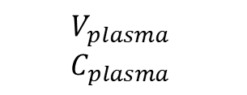

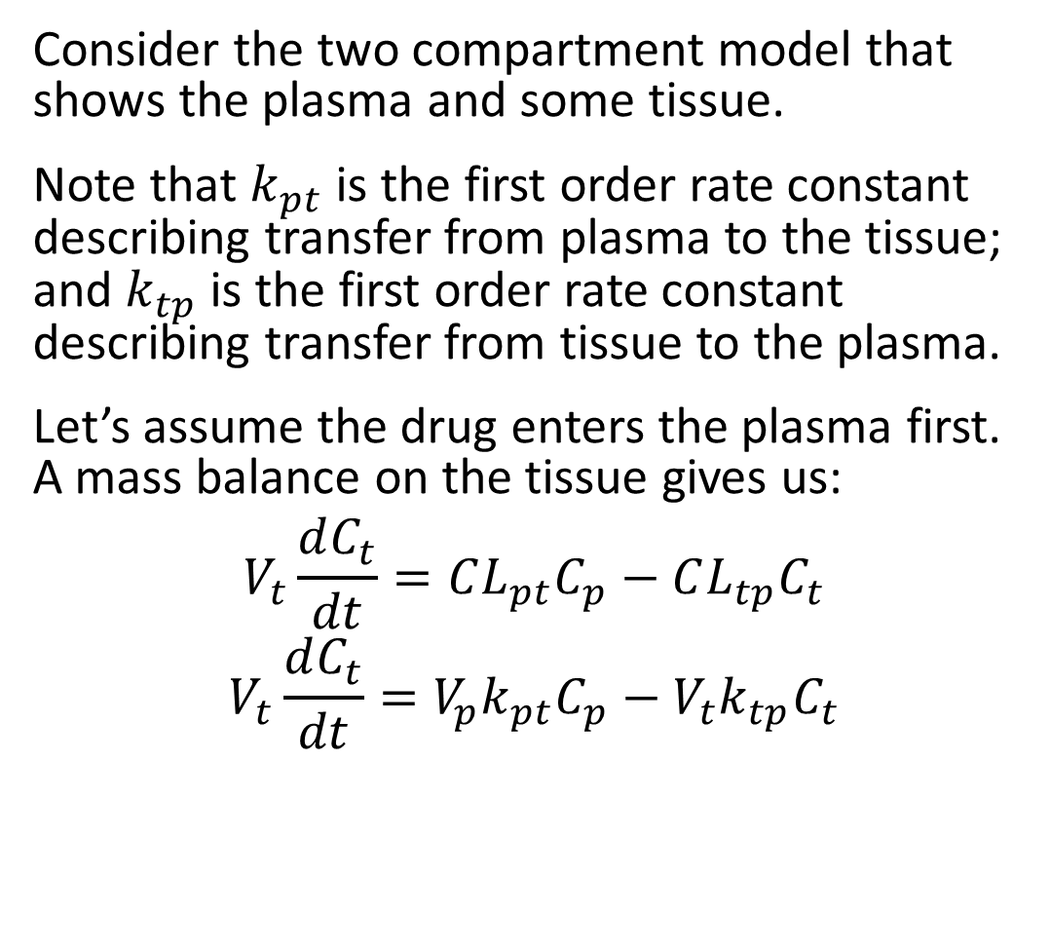



Two Compartment Model
$$V_{tissue}$$
$$C_{tissue}$$
Consider the two compartment model that shows the plasma and some tissue.
Note that $k_{pt}$ is the first order rate constant describing transfer from plasma to the tissue; and $k_{tp}$ is the first order rate constant describing transfer from tissue to the plasma.
Let’s assume the drug enters the plasma first. A mass balance on the tissue gives us:
$$V_{t}\frac{dC_{t}}{dt}=CL_{pt}C_{p}−CL_{tp}C_{t}$$
$$V_{t}\frac{dC_{t}}{dt}=V_{p}k_{pt}C_{p}−V_{t}k_{tp}C_{t}$$
$$k_{pt}$$
$$k_{tp}$$
Drug
$$V_{plasma}$$
$$C_{plasma}$$
$$k_{e}$$
Clearance by excretion

Slide 16
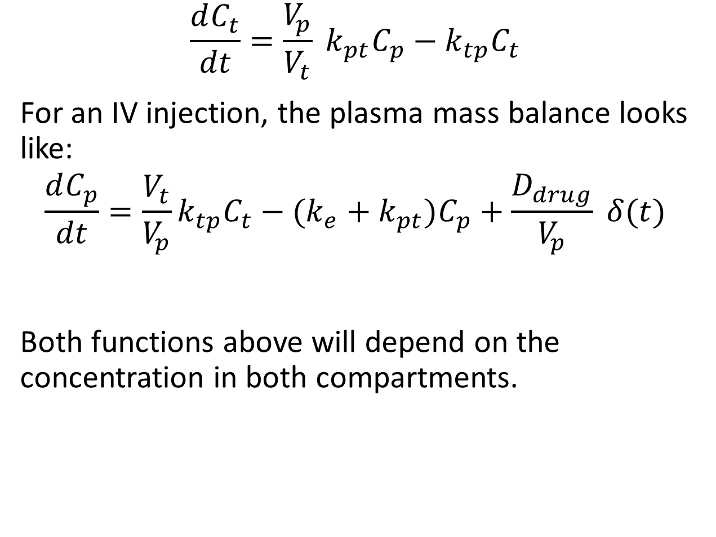
Two Compartment Model
$$V_{tissue}$$
$$C_{tissue}$$
$$\frac{dC_{t}}{dt}=\frac{V_{p}}{V_{t}} k_{pt}C_{p}−k_{tp}C_{t}$$
For an IV injection, the plasma mass balance looks like:
$$\frac{dC_{p}}{dt}=\frac{V_{t}}{V_{p}}k_{tp}C_{t}−(k_{e}+k_{pt})C_{p}+\frac{D_{drug}}{V_{p}} δ(t)$$
Both functions above will depend on the concentration in both compartments.
$$k_{pt}$$
$$k_{tp}$$
Drug
$$V_{plasma}$$
$$C_{plasma}$$
$$k_{e}$$
Clearance by excretion

Slide 17
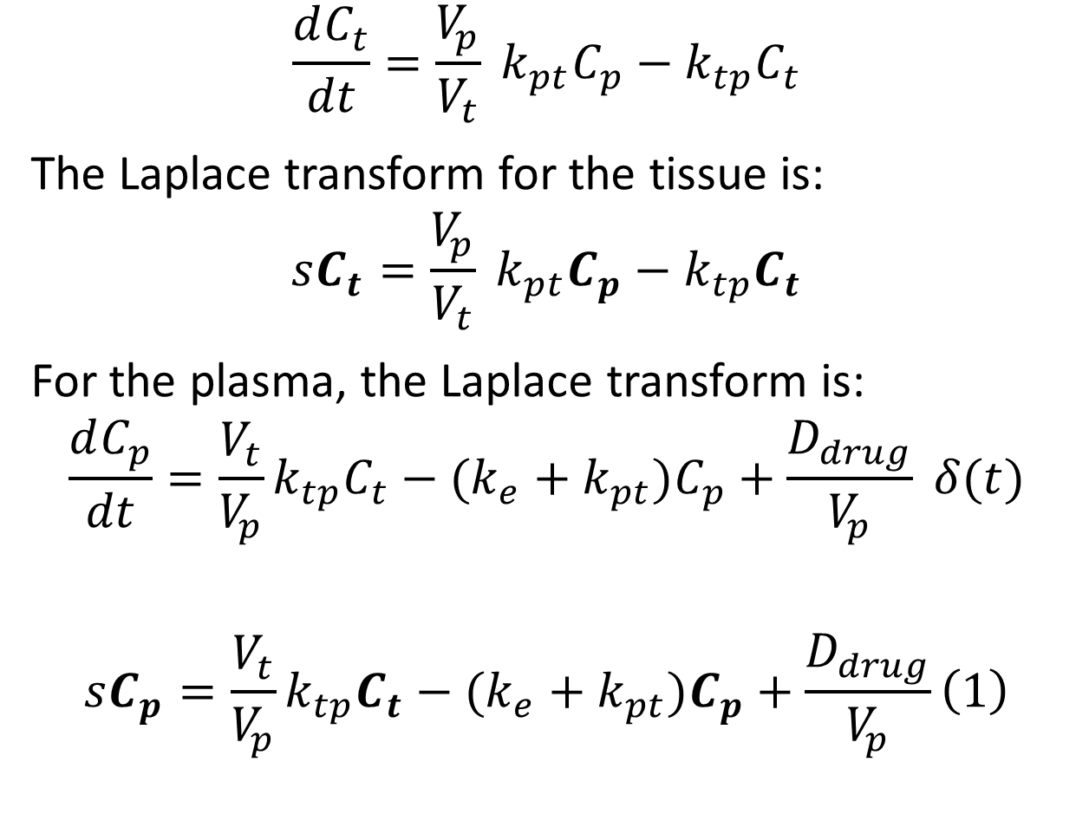
Two Compartment Model
$$V_{tissue}$$
$$C_{tissue}$$
$$\frac{dC_{t}}{dt}=\frac{V_{p}}{V_{t}} k_{pt}C_{p}−k_{tp}C_{t}$$
The Laplace transform for the tissue is:
$$sC_{t}=\frac{V_{p}}{V_{t}} k_{pt}C_{p}−k_{tp}C_{t}$$
For the plasma, the Laplace transform is:
$$\frac{dC_{p}}{dt}=\frac{V_{t}}{V_{p}}k_{tp}C_{t}−(k_{e}+k_{pt})C_{p}+\frac{D_{drug}}{V_{p}} δ(t)$$
$$sC_{p}=\frac{V_{t}}{V_{p}}k_{tp}C_{t}−(k_{e}+k_{pt})C_{p}+\frac{D_{drug}}{V_{p}}\left(1\right)$$
$$k_{pt}$$
$$k_{tp}$$
Drug
$$V_{plasma}$$
$$C_{plasma}$$
$$k_{e}$$
Clearance by excretion

Slide 18
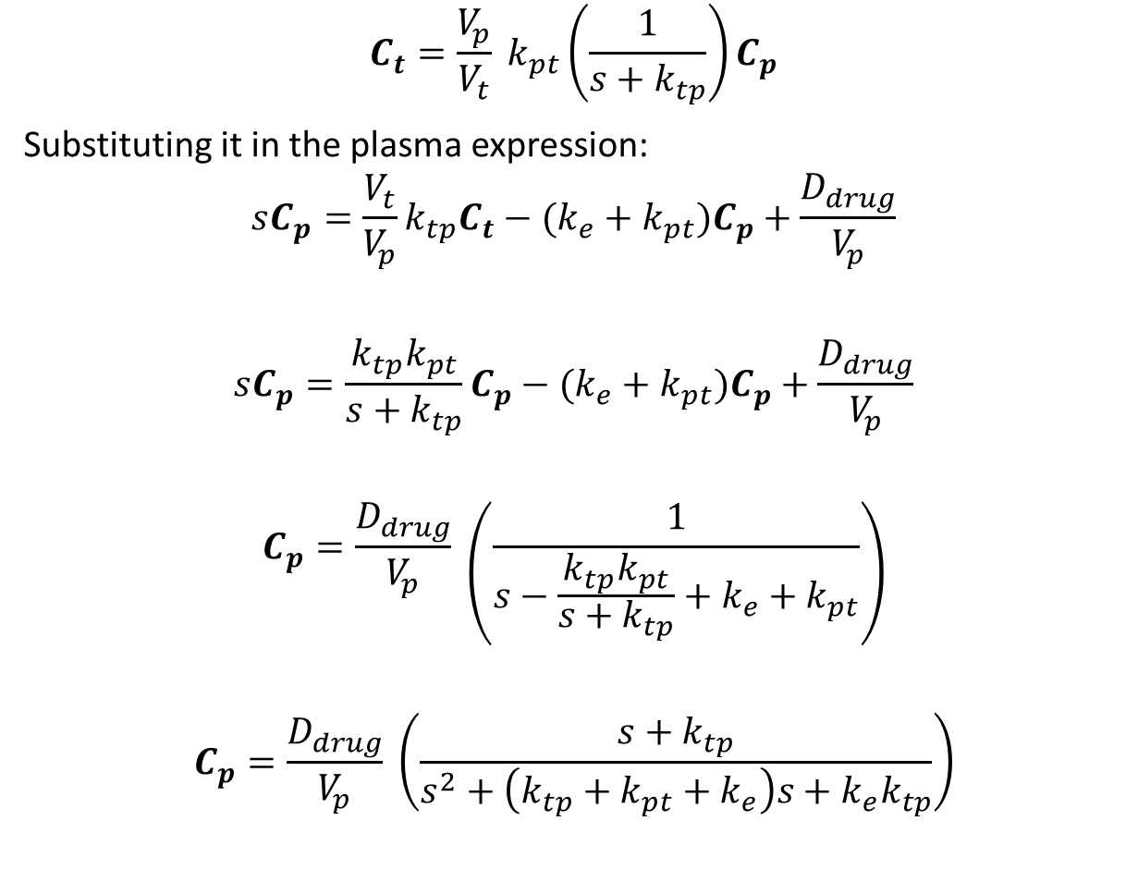
Two Compartment Model
$$V_{tissue}$$
$$C_{tissue}$$
$$C_{t}=\frac{V_{p}}{V_{t}} k_{pt}\left(\frac{1}{s+k_{tp}}\right)C_{p}$$
Substituting it in the plasma expression:
$$sC_{p}=\frac{V_{t}}{V_{p}}k_{tp}C_{t}−(k_{e}+k_{pt})C_{p}+\frac{D_{drug}}{V_{p}}$$
$$sC_{p}=\frac{k_{tp}k_{pt}}{s+k_{tp}}C_{p}−(k_{e}+k_{pt})C_{p}+\frac{D_{drug}}{V_{p}}$$
$$C_{p}=\frac{D_{drug}}{V_{p}} \left(\frac{1}{s−\frac{k_{tp}k_{pt}}{s+k_{tp}}+k_{e}+k_{pt}}\right)$$
$$C_{p}=\frac{D_{drug}}{V_{p}} \left(\frac{s+k_{tp}}{s^{2}+\left(k_{tp}+k_{pt}+k_{e}\right)s+k_{e}k_{tp}}\right)$$
$$k_{pt}$$
$$k_{tp}$$
Drug
$$V_{plasma}$$
$$C_{plasma}$$
$$k_{e}$$
Clearance by excretion

Slide 19
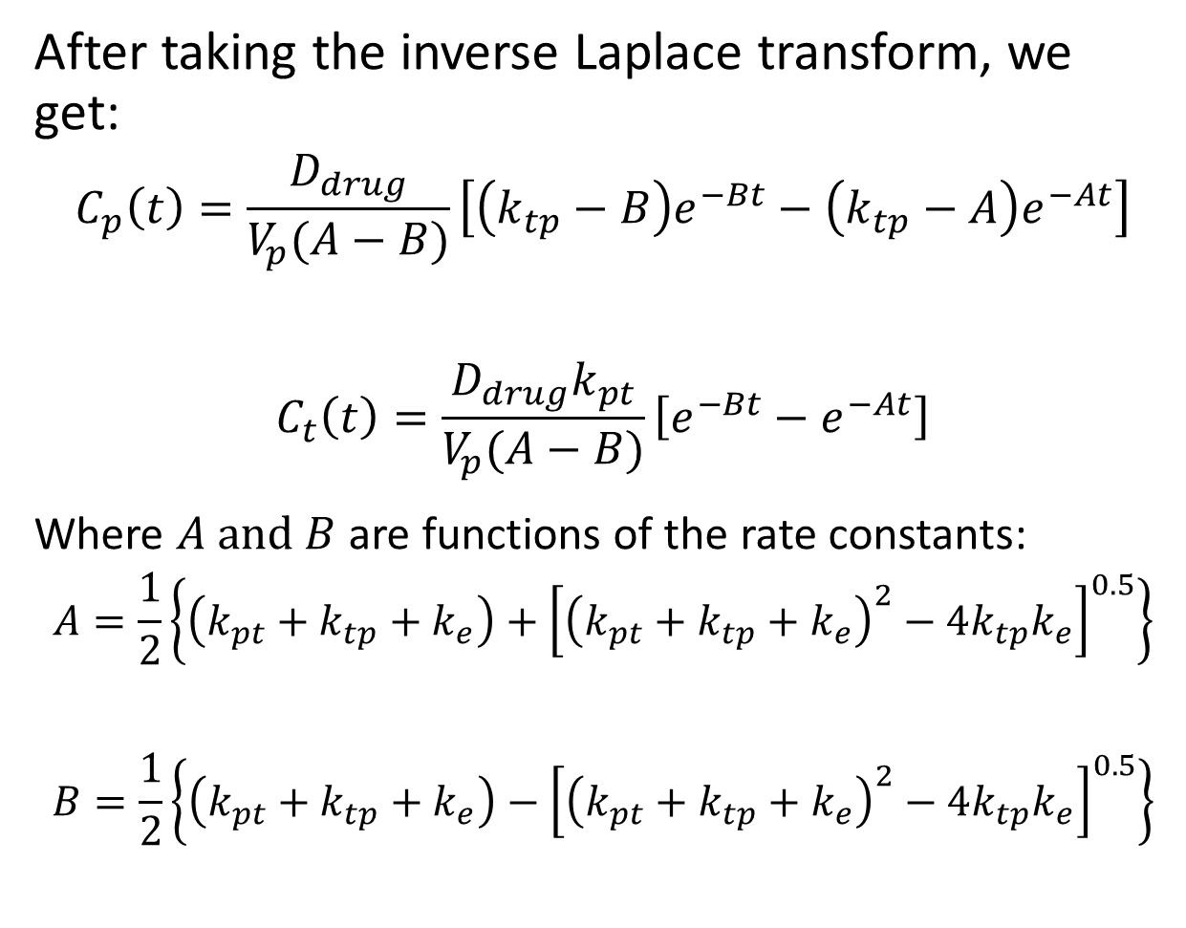
Two Compartment Model
$$V_{tissue}$$
$$C_{tissue}$$
After taking the inverse Laplace transform, we get:
$$C_{p}\left(t\right)=\frac{D_{drug}}{V_{p}(A−B)}\left[\left(k_{tp}−B\right)e^{−Bt}−\left(k_{tp}−A\right)e^{−At}\right]$$
$$C_{t}\left(t\right)=\frac{D_{drug}k_{pt}}{V_{p}(A−B)}\left[e^{−Bt}−e^{−At}\right]$$
Where $A \text{and} B$ are functions of the rate constants:
$$A=\frac{1}{2}\left\{\left(k_{pt}+k_{tp}+k_{e}\right)+{\left[{\left(k_{pt}+k_{tp}+k_{e}\right)}^{2}−4k_{tp}k_{e}\right]}^{0.5}\right\}$$
$$B=\frac{1}{2}\left\{\left(k_{pt}+k_{tp}+k_{e}\right)−{\left[{\left(k_{pt}+k_{tp}+k_{e}\right)}^{2}−4k_{tp}k_{e}\right]}^{0.5}\right\}$$
$$k_{pt}$$
$$k_{tp}$$
Drug
$$V_{plasma}$$
$$C_{plasma}$$
$$k_{e}$$
Clearance by excretion

Slide 20
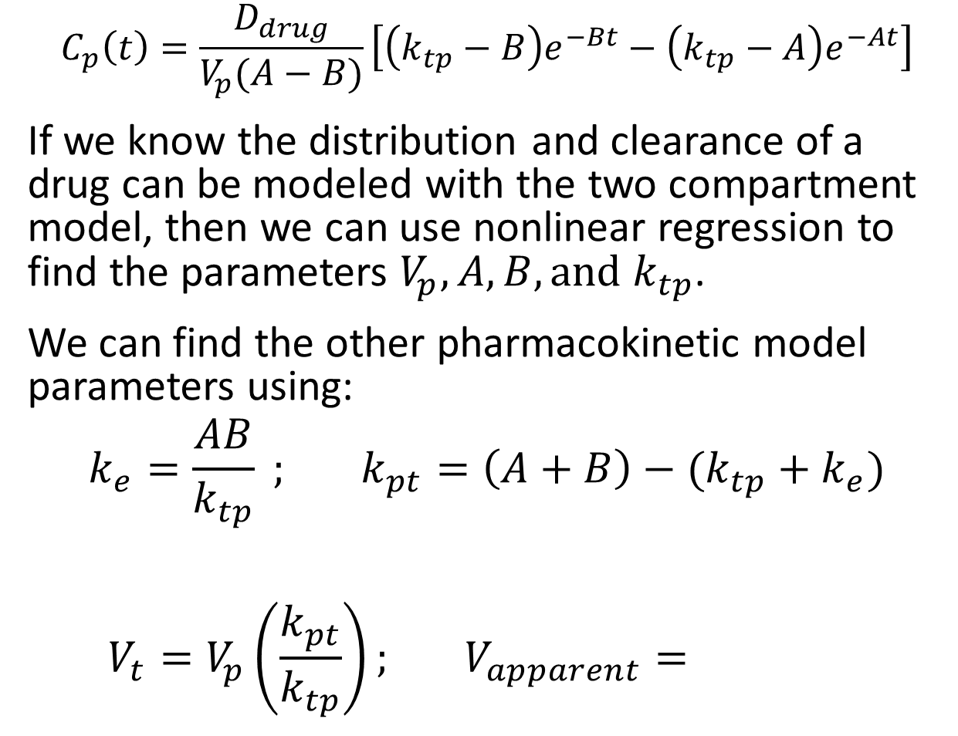
Two Compartment Model
$$V_{tissue}$$
$$C_{tissue}$$
$$C_{p}\left(t\right)=\frac{D_{drug}}{V_{p}(A−B)}\left[\left(k_{tp}−B\right)e^{−Bt}−\left(k_{tp}−A\right)e^{−At}\right]$$
If we know the distribution and clearance of a drug can be modeled with the two compartment model, then we can use nonlinear regression to find the parameters $V_{p},A,B,\text{and} k_{tp}$.
We can find the other pharmacokinetic model parameters using:
$$k_{e}=\frac{AB}{k_{tp}} ; k_{pt}=\left(A+B\right)−(k_{tp}+k_{e})$$
$$V_{t}=V_{p}\left(\frac{k_{pt}}{k_{tp}}\right); V_{apparent}=$$
$$k_{pt}$$
$$k_{tp}$$
Drug
$$V_{plasma}$$
$$C_{plasma}$$
$$k_{e}$$
Clearance by excretion

Slide 21
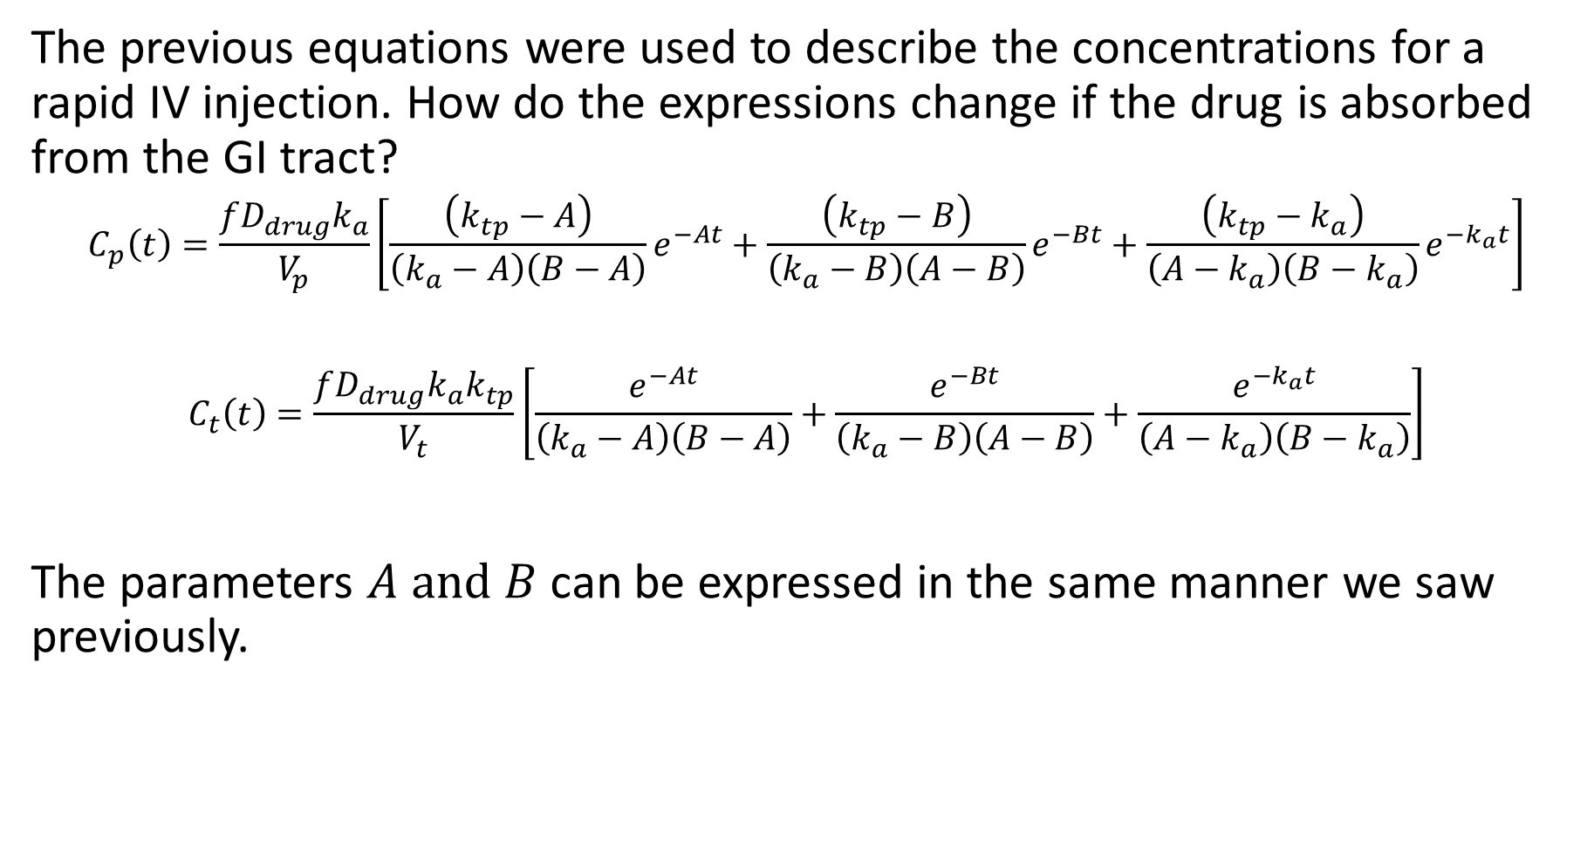
Two Compartment Model – Drug Absorption
The previous equations were used to describe the concentrations for a rapid IV injection. How do the expressions change if the drug is absorbed from the GI tract?
$$C_{p}\left(t\right)=\frac{fD_{drug}k_{a}}{V_{p}}\left[\frac{\left(k_{tp}−A\right)}{\left(k_{a}−A\right)\left(B−A\right)}e^{−At}+\frac{\left(k_{tp}−B\right)}{\left(k_{a}−B\right)\left(A−B\right)}e^{−Bt}+\frac{\left(k_{tp}−k_{a}\right)}{\left(A−k_{a}\right)\left(B−k_{a}\right)}e^{−k_{a}t}\right]$$
$$C_{t}\left(t\right)=\frac{fD_{drug}k_{a}k_{tp}}{V_{t}}\left[\frac{e^{−At}}{\left(k_{a}−A\right)\left(B−A\right)}+\frac{e^{−Bt}}{\left(k_{a}−B\right)\left(A−B\right)}+\frac{e^{−k_{a}t}}{\left(A−k_{a}\right)\left(B−k_{a}\right)}\right]$$
The parameters $A \text{and} B$ can be expressed in the same manner we saw previously.

Slide 22
Nonlinear-Regression Modeling
We will use the following data collected:
Assume that the initial dose was 4 mg through a rapid IV injection.
We will use Excel and nonlinear regression to determine the pharmacokinetic parameters.
Time (min) | Drug Plasma Concentration (μg/mL)
15 | 352
30 | 256
60 | 160
90 | 120
135 | 88
180 | 64
225 | 48
262 | 38
315 | 28
360 | 20

Slide 23
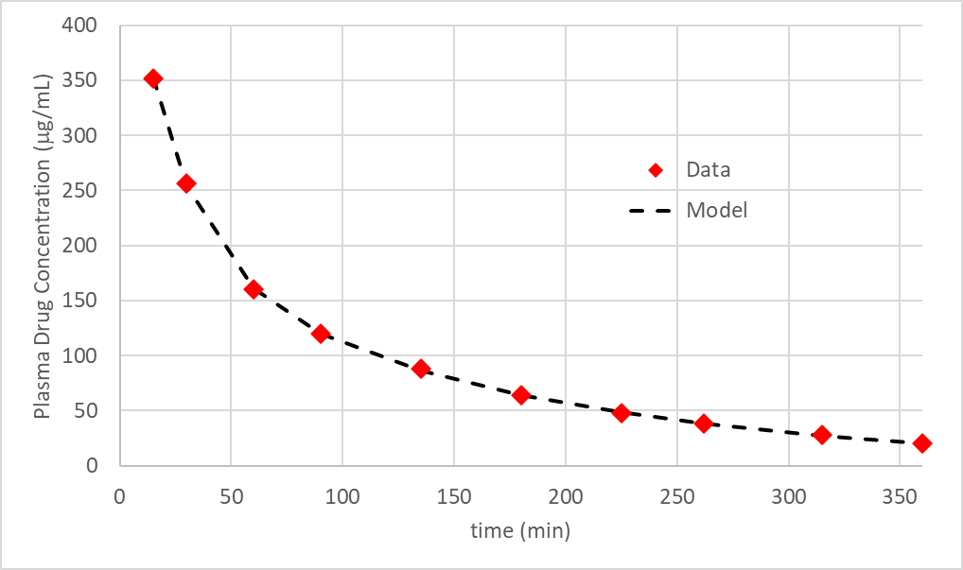
Nonlinear-Regression Modeling

